Slide 1
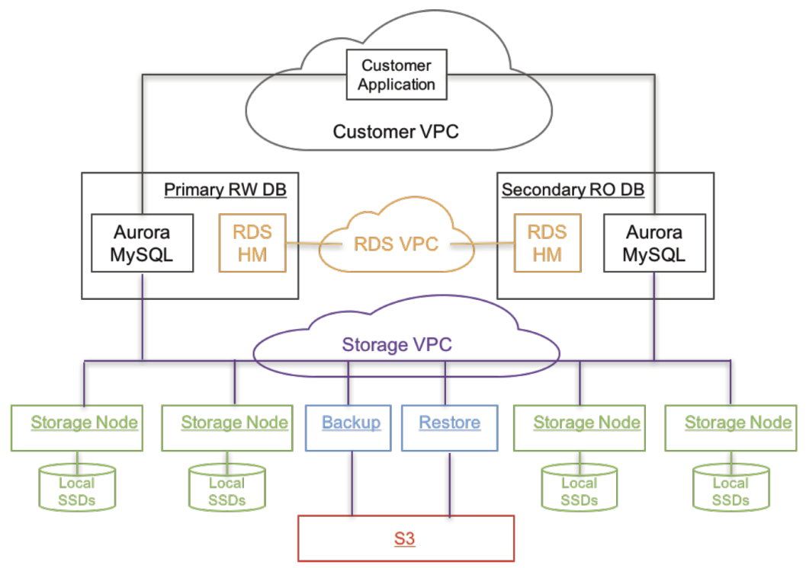
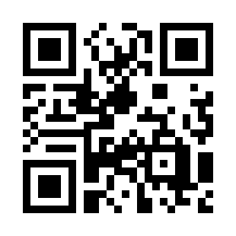
Amazon Aurora
https://bit.ly/3YJhrH5

